Slide 1
Data Structure and Algorithm (PMSCS 623P)
Lecture 9
Graph

Slide 2
Graphs and Graph Models
Definition 1: A graph G = (V , E ) consists of V, a nonempty set of vertices (or nodes) and E, a set of edges. Each edge has either one or two vertices associated with it, called its endpoints. An edge is said to connect its endpoints.

Slide 3
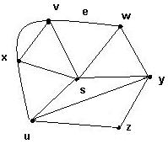
Summary
It is a pair G = (V, E ), where
V = V (G ) = Set of vertices
E = E (G ) = Set of edges
Example:
V = {s, u, v, w, x, y, z}
E = {(x, s), (x, v), (x, u), (v, w), (s, v), (s, u),
(s, w), (s, y), (w, y), (u, y), (u, z), (y, z)}

Slide 4
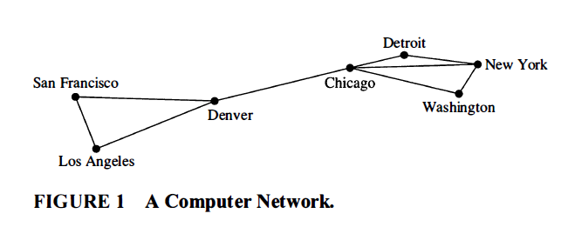
Example
This computer network can be modeled using a graph in which the vertices of the graph represent the data centers and the edges represent communication links.

Slide 5
Simple Graphs
A graph in which each edge connects two different vertices and where no more than one edge connect the same pair of vertices is called a simple graph.
e.g. The graph in figure 1 is an example of a simple graph.

Slide 6
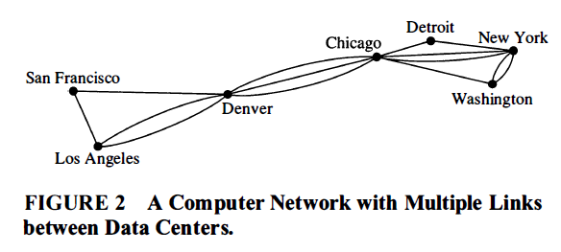
Multigraphs
A computer network may contain multiple links between data centers, as shown in Figure 2. To model such networks we need graphs that have more than one edge connecting the same pair of vertices. Graphs that may have multiple edges connecting the same vertices are called multigraphs.

Slide 7
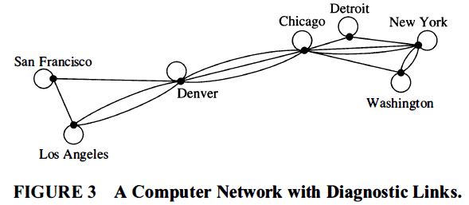
Pseudographs
Sometimes a communication link connects a data center with itself. To model this network we need to include edges that connect a vertex to itself. Such edges are called loops. Graphs that may include loops, and possibly multiple edges are sometimes called pseudographs.

Slide 8
Directed Graphs
Definition 2: A directed graph (or digraph) (V , E ) consists of a nonempty set of vertices V and a set of directed edges (or arcs) E. Each directed edge is associated with an ordered pair of vertices.
The directed edge associated with the ordered pair (u, v) is said to start at u and end at v. When a directed graph has no loops and has no multiple directed edges, it is called a simple directed graph.

Slide 9
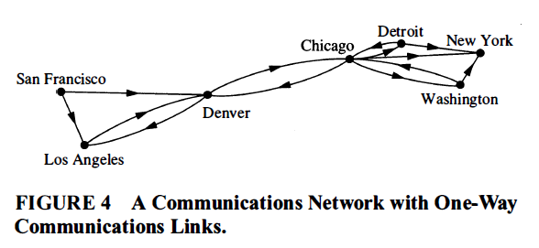
Simple Directed Graph

Slide 10
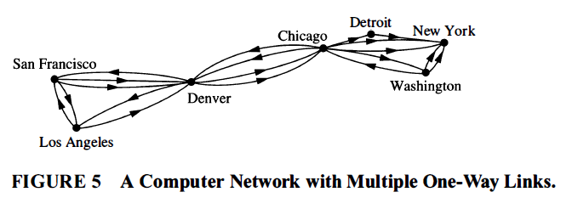
Directed Multigraph
Directed graphs that may have multiple directed edges from a vertex to a second (possibly the same) vertex are to used model such networks. We call such graphs directed multigraphs.

Slide 11
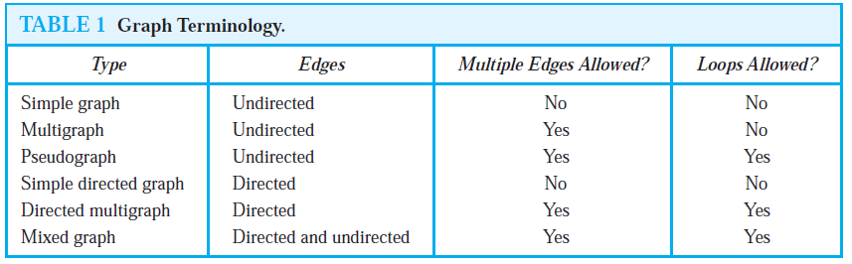

Slide 12
Graph Terminology
Adjacent, connects, endpoints, degree, initial,
terminal, in-degree, out-degree, complete,
complete bipartite, cycles, wheels, n-cubes.

Slide 13
Undirected Graph: Adjacency
Let G be an undirected graph with edge set E. Let e ∈ E where e = {u ,v}. We say that:
The vertices u and v are adjacent / neighbors / connected.
The edge e is incident with vertices u and v.
The edge e connects u and v.
The vertices u and v are endpoints of the edge e.

Slide 14
Undirected Graph: Degree of a Vertex
Let G be an undirected graph, v ∈V a vertex.
The degree of v, deg(v), is its number of incident edges. (Except that any self-loops are counted twice.)
A vertex with degree 0 is isolated.
A vertex of degree 1 is pendant.

Slide 15
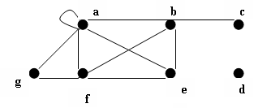
deg(a ) = 6
deg(b ) = 4
deg(c ) = 1 pendant
deg(d ) = 0 isolated
deg(e ) = 3
deg(f ) = 4
deg(g ) = 2

Slide 16
Directed Graph: Adjacency
Let G be a directed (possibly multi-) graph, and let e be an edge of G that is (u ,v). Then we say:
u v
u is adjacent to v, v is adjacent from u
e comes from u, e goes to v.
e connects u to v, e goes from u to v
The initial vertex of e is u
The terminal vertex of e is v

Slide 17
Directed Graph: Degree of a vertex
Let G be a directed graph and v a vertex of G.
The in-degree of v, deg⁻(v), is the number of edges going to v (v is terminal).
The out-degree of v, deg⁺(v), is the number of edges coming from v (v is initial).
The degree of v, deg(v) = deg⁻(v) + deg⁺(v), is the sum of v’s in-degree and out-degree.
A loop at a vertex contributes 1 to both in-degree and out-degree of this vertex.

Slide 18
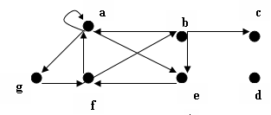
deg⁺(a ) = 3 deg⁻(a ) = 3
deg⁺(b ) = 3 deg⁻(b ) = 1
deg⁺(c ) = 0 deg⁻(c ) = 1
deg⁺(d ) = 0 deg⁻(d ) = 0
Deg⁺(e ) = 1 deg⁻(e ) = 2
Deg⁺(f ) = 2 deg⁻(f ) = 2
Deg⁺(g ) = 1 deg⁻(g ) = 1

Slide 19
Graph Representations
Graph representations:
Adjacency Lists.
Adjacency Matrices.
Incidence Matrices.

Slide 20
Undirected: Adjacency Lists
A table with 1 row per vertex, listing its adjacent vertices.
a
b
c
d
e
f

Slide 21
Undirected: Adjacency Matrices
Matrix A = [a_{ij}], where a_{ij} is 1 if {v_{i} ,v_{j} } is an edge of G, 0 otherwise.
a
b
a b c d e
c
e
d

Slide 22
Example 1
Draw a graph using the following adjacency matrix A with respect to the vertices: a, b, c, d :
a
b
d
c

Slide 23
Example 2
Find an adjacency matrix that represents the graph:
a b c d
a
b
a
b
c
d
c
d

Slide 24
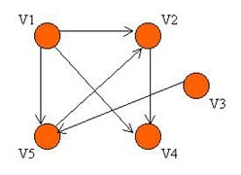
Directed Adjacency Lists
1 row per node, listing the terminal nodes of each edge incident from that node.
Initial vertex | Terminal vertices
V1 | V2, V4, V5
V2 | V4
V3 | V5
V4
V5 | V2

Slide 25
Directed Adjacency Matrices
Matrix A = [a_{ij}], where a_{ij} is 1 if {v_{i} ,v_{j} } is an edge of G, 0 otherwise.
a
b
a b c d e
c
e
d

Slide 26
Incidence Matrices
It is a matrix A = [a_{ij}], where a_{ij} is 1 if the edge e_{j} is incident with the vertex v_{i} , 0 otherwise.
e₁
e₁ e₂ e₃ e₄
1
2
e₂
e₄
e₃
3
4
5

Slide 27
Example
Let A be the incident matrix of a graph G. Draw G.
Let G = {V, E},
where V= {a, b, c, d} and
E = {e₁, e₂, e₃, e₄, e₅}.
e₂
a
b
e₃
e₄
e₅
d
c
e₁

